Slide 1
Backtracking

Slide 2
Backtracking
也叫试探法，它是一种系统地搜索问题的解的方法。
基本思想：从一条路往前走，能进则进，不能进则退回来，换一条路再试。
典型例子：八皇后问题；迷宫问题

Slide 3
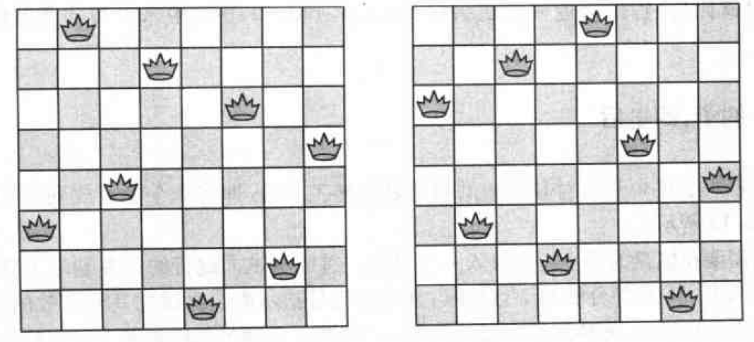
How to place eight queens on a chessboard so that no queen can take another.
A queen can take another queen that lies
  On the same row
  The same column
  The same diagonal (either direction)

Slide 4
Solving the Eight-Queens Puzzle
Start to put queens on the board randomly or in some logical order, but always making sure that no queen placed can take another already on the board.
If eight queens have been put on the board, this is a solution. If not, one or more of the queens must be removed and placed elsewhere to continue the search for the solution.

Slide 5
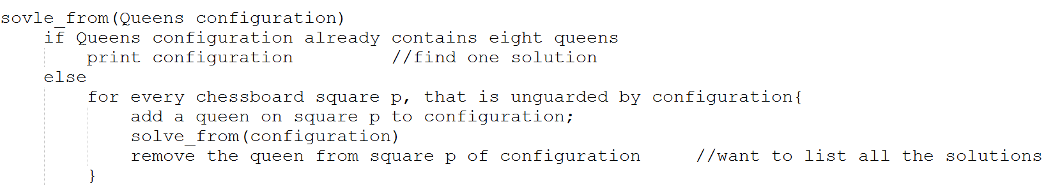
Outline
solve_from
Class Queens
  Tracing a partial configuration of queens
outline

Slide 6
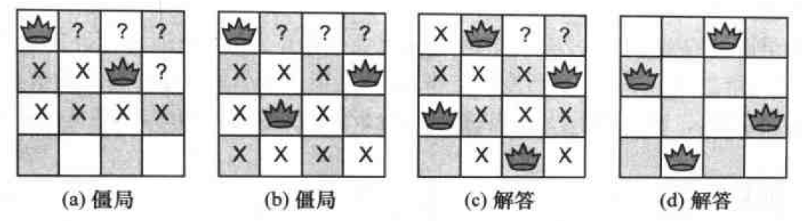
Example: four queens

Slide 7
backtracking
Backtracking algorithm:
  Attempt to complete a search for a solution to a problem by constructing partial solutions remain consistent with the requirements of the problem.
  Then extends a partial solution toward completion, but when an inconsistency with the requirements of the problem occurs, the algorithm backs up by removing the most recently constructed part of the solution and trying another possibility.

Slide 8
Overall outline
The main program
  p186
The Queens Class
  P187
The backtracking function
  p188

Slide 9
Refinement
The first implementation:
  Definition of the class: p188
  Key methods:
    insert: p189
    Constructor: p189
    unguarded: p191

Slide 10
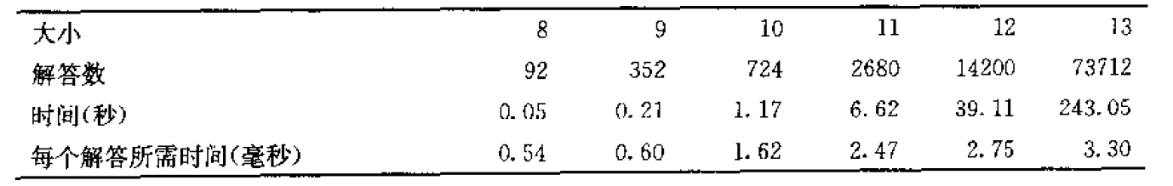
Refinement
Further on:
  The number of solutions increases rapidly with the size of the board, and the time increases even more rapidly, since even the time per solution increases with the size

Slide 11
Refinement
Further on:
  Where our program spends most of its time?
    Recursive calls and backtracking
    Loops in the method unguarded()
  Solutions
    1. Keep track of all the squares that are guarded by queens —— keep a count of the number of queens guarding the square
    2. Keep track of unguarded squares by using three arrays.

Slide 12
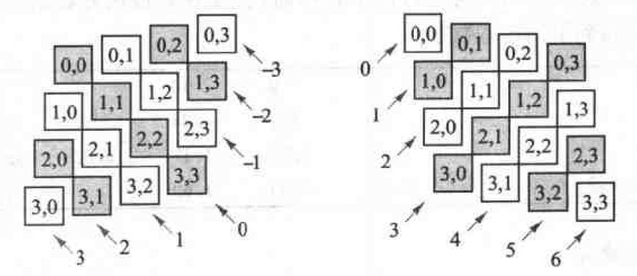
Refinement
Further on:
  Solution 2:
    Key idea: each row, column, and diagonal on the chessboard can contain at most one queen.
    Three bool arrays:
      col_free[max_board]
      upward_free[2*max_board-1]
      downward_free[2*max_board-1]

Slide 13
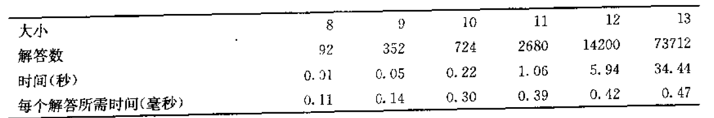
Refinement
Further on:
  Solution 2:
    Revised Queen data structure: p193-194
    Under the same condition, the timing data:

Slide 14



Analysis of Backtracking
Effectiveness of backtracking
  Only for 8*8 case:
    All permutations:
    Only one queen in each row:
    Reject squares whose column or diagonals are guarded.
  Effectiveness of backtracking:
    Positions that are discovered to be impossible prevent the later investigation of fruitless paths.

Slide 15
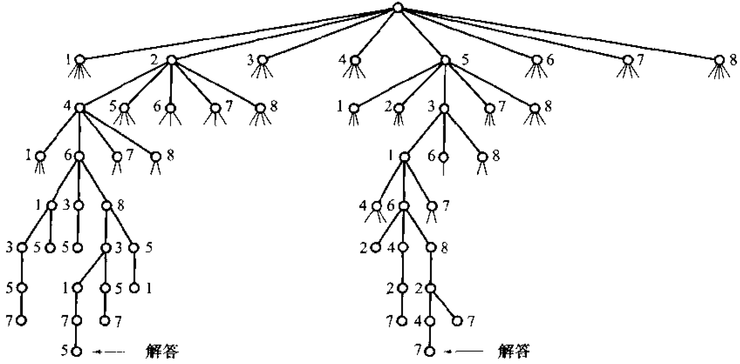
Analysis of Backtracking
Effectiveness of backtracking
  Effectiveness of backtracking:

